Slide 2
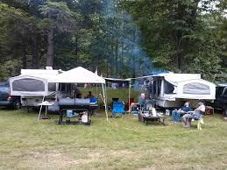
Camping Details
Plenty of camping available!
Rough & Electric Sites
Electric sites 15amp only no air conditioners
No on site sewer - dump site available on grounds
Rough Camping - $10.00 Per Night
Electric Sites - $20.00 Per Night

